Slide 1
Agentic AI Roadmap
CAPSTONE PROJECT
Presented By
Student name : EDUPUGANTI D V V B PAVAN KUMAR
College Name & Department : VISHNU INSTITUTE OF TECHNOLOGY & INFORMATION TECHNOLOGY

Slide 2
OUTLINE
Problem Statement
Technology used
Wow factor
End users
Result
Conclusion
Git-hub Link
Future scope
IBM Certifications

Slide 3
Problem Statement
Developers struggle with building agentic systems due to scattered resources and lack of structured guidance.
Proposed Solution: AgenticAI Roadmap - a dynamic AI-powered platform that curates, visualizes, and recommends agent-building content and tools.

Slide 4
Technology used
IBM Cloud Watsonx AI Studio
IBM Watsonx AI Runtime
IBM Granite Foundation Models
NLP + Retrieval-Augmented Generation (RAG)
LangChain / Haystack / OpenAI API

Slide 5
IBM cloud services used
IBM Watsonx.ai — For building and managing the conversational AI agent
Vector Index Tool (Watsonx) — For retrieving personalized learning roadmap content
mistral-large Foundation Model — Used as the LLM to generate responses based on user input
IBM Deployment Space — For deploying and testing the agent
IBM Cloud Object Storage — For storing custom content like roadmap files

Slide 6
Wow factors
This agent dramatically simplifies personalized learning for students, reduces the cognitive load of choosing the right learning path, and enables dynamic upskilling aligned with individual goals. It empowers students, job seekers, and educators with guided, intelligent, and adaptive learning journeys.
Unique Features:
Semantic retrieval of learning content via vector indexing
Dynamic weekly course roadmaps generated through user interaction
Adaptive guidance based on user interest: Frontend, AI, Cybersecurity, etc.
Prompt-aware response filtering to avoid irrelevant information overload
Minimal-input interaction for beginner-friendly experience
Future-ready structure: Easily extendable to include certifications, projects, and live tracking
Deployed on IBM Cloud — secure, scalable, and enterprise-grade
API-ready service that can be embedded in educational platforms

Slide 7
End users
Students (School & College Level) Looking for personalized guidance to choose and follow learning paths.
Academic Institutions & Universities Integrating AI advisors into learning management systems to support student development.
Job Seekers & Fresh Graduates Needing structured roadmaps to gain industry-relevant skills for employment.
EdTech Platforms Enhancing course discovery and user engagement with AI-driven learning suggestions
Career Counselors and Academic Advisors Using the tool to scale personalized learning recommendations efficiently.

Slide 8
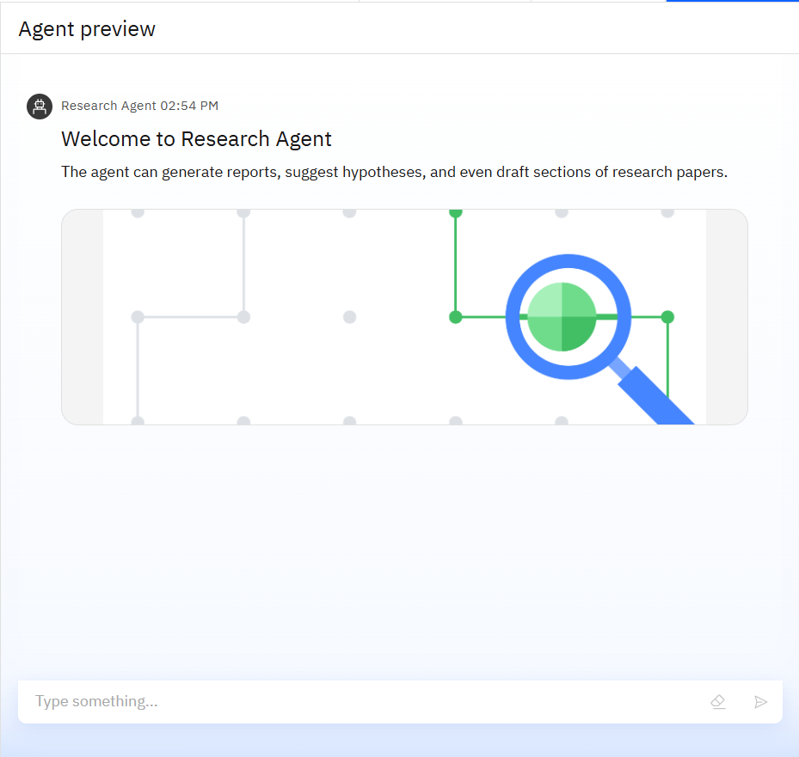
Results
Built an AI agent capable of understanding user goals and generating personalized plans.
Used Watsonx tools and RAG to provide relevant, structured responses.
Demonstrated the agent’s ability to assist in career planning and learning paths.

Slide 9
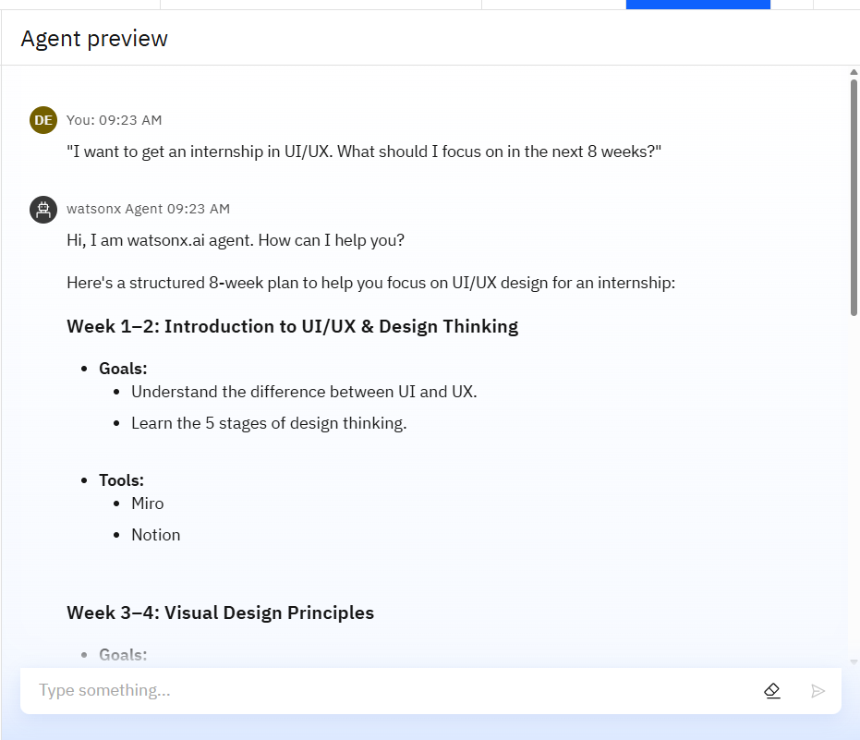
Results
The Agent Responds With:
A structured 8-week roadmap tailored to the user’s goal.
Breakdown into weekly modules (e.g., Design Thinking, Visual Principles).
Specific learning goals and tools (e.g., Miro, Notion).
Dynamic and modular learning guidance. Demonstrates the agent’s ability to contextualize user goals.
Provides actionable, domain-specific advice instantly.
Example of personalized curriculum generation using agentic design.

Slide 10
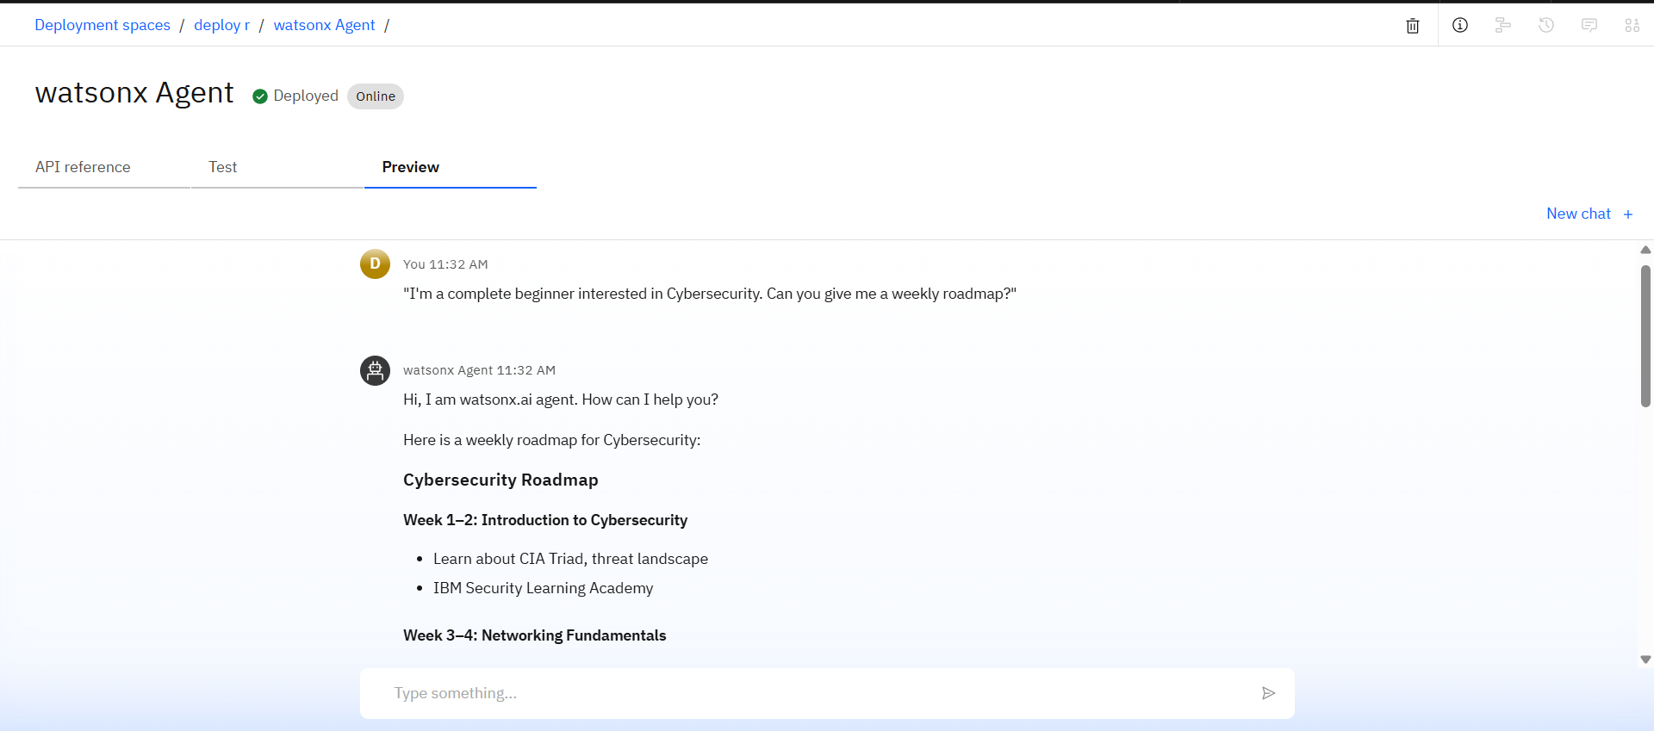
Results
Deployed AI Agent
The agent is deployed and online, indicating that it’s fully functional and ready for user interaction.
Users can test the agent’s performance directly in the Preview tab.
Demonstrates the agent's ability to respond to real user queries in real-time.
This confirms the transition from development to a working, interactive prototype.

Slide 11
Conclusion
Successfully built an AI agent that delivers personalized learning roadmaps based on user input.
Integrated IBM Watsonx and RAG to enable accurate, real-time responses.
Demonstrated applications in domains like UI/UX and Cybersecurity.
Showcased how agentic AI can enhance learning, decision-making, and user engagement.

Slide 12
Future scope
Voice-activated interaction for hands-free user experience.
Personalized user profiles to track progress and goals.
Multi-domain support (e.g., Data Science, Healthcare, Cloud).
Mobile app or chatbot integration for broader accessibility.
Real-time content updates using web APIs and live sources.

Slide 13
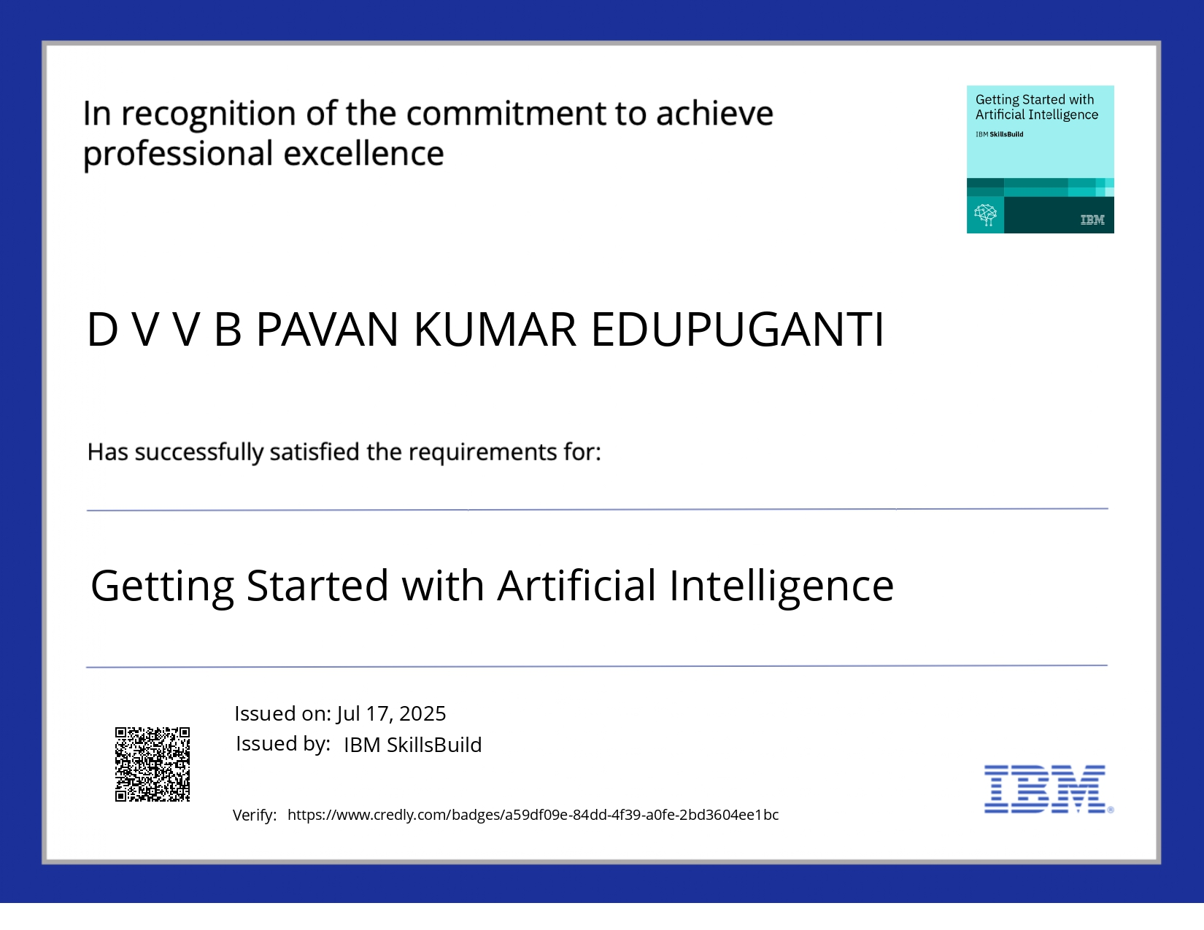
IBM Certifications

Slide 14
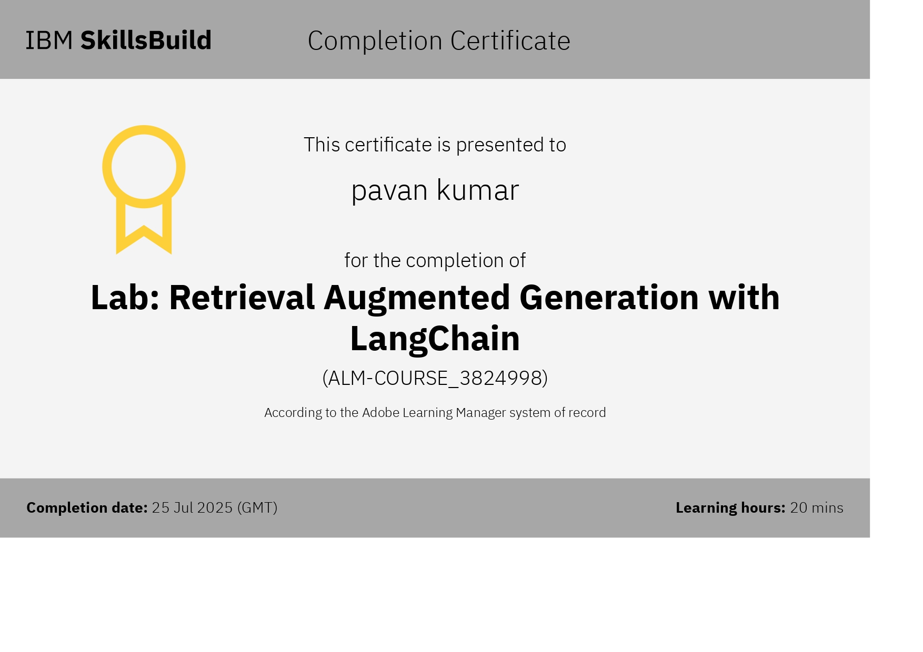
RAG LAB CERTIFICATE

Slide 15
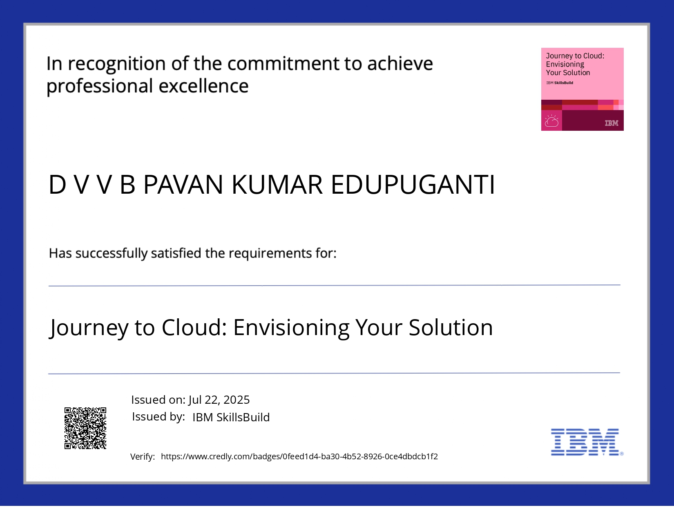
JOURNEY TO CLOUD

Slide 16
GitHub Link
Make sure that there should be readme file

Slide 17
THANK YOU

